Slide 1

Artificial intelligence
Lecture 2. Regression problem – linear regression
prof. Krzysztof Rybinski

Slide 2
The problem
Ability to predict quality of wine by an expert is a very highly priced skill
Can we build a model that will use simple data and make predictions that are as good or even better than expert forecast
In March 1990 Orley Ashenfelter, a Princeton economics professor, claims he can predict wine quality without tasting the wine
Robert Parker, world most famous wine tester call economics professor „an absolute total sham”
Ashenfelter built a linear regression model
Based on MIT course: Analytics Edge

Slide 3
The data
Ashenfelter linear regression model
Predicts an outcome variable, or dependent variable – wine price, which approximates quality (wine auction price in 1990-1991)
Independent variables:
    Age – older wines are more expensive
    Weather:
    Average Growing Season Temperature
    Harvest Rain
    Winter Rain
Wine produced in years 1952 - 1978

Slide 4
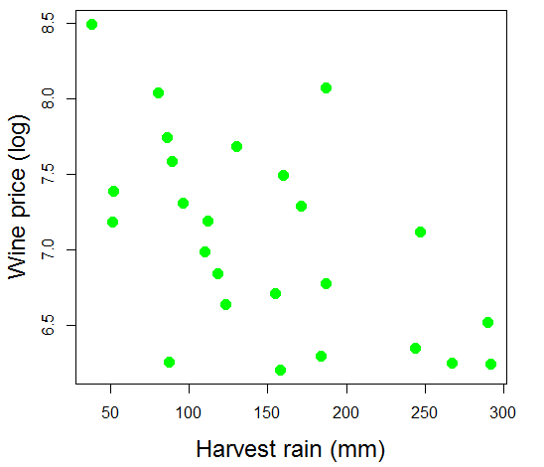
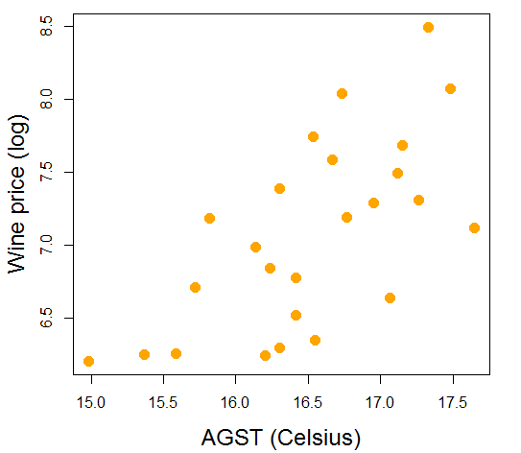
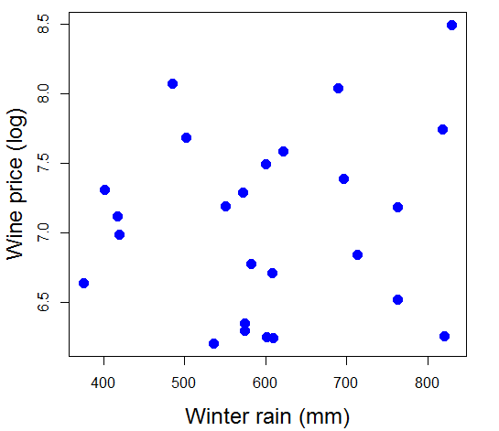
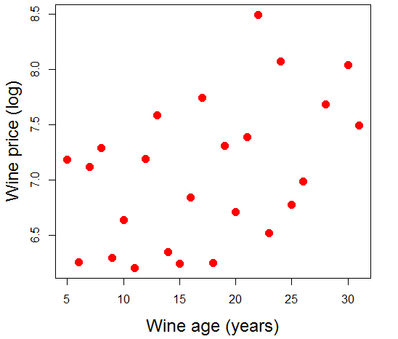
The data

Slide 5
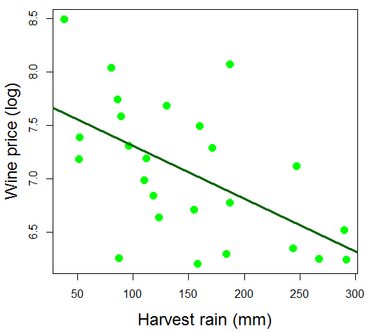
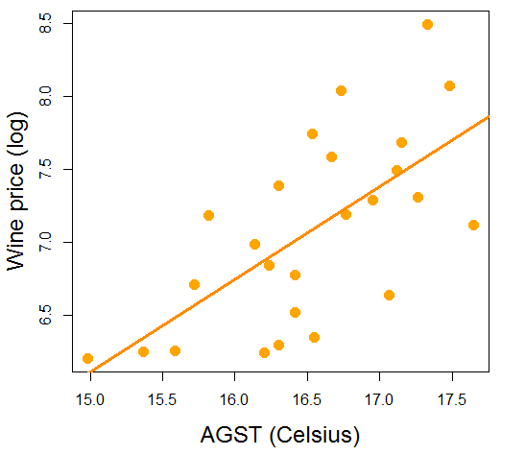
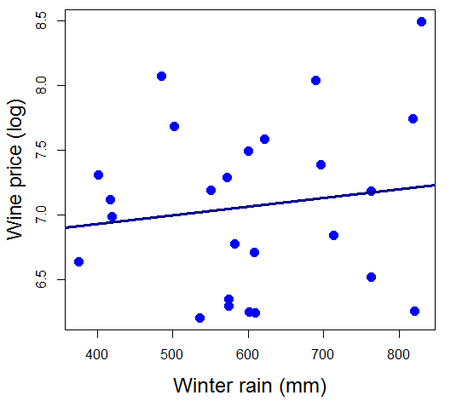
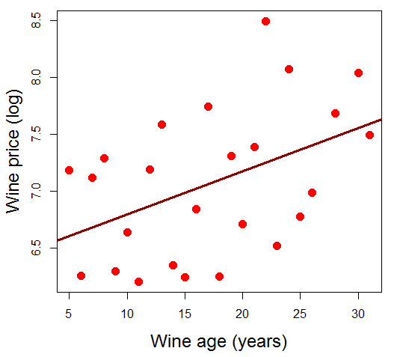
The data and linear relationships

Slide 6


The data and linear relationships
y= 7.9-0.0049x
y= -3.42+0.635x
y= 6.66+0.00067x
y= 6.42+0.037x

Slide 7
Intuition of a base model
You know nothing about the student that will enter the room, please predict his height
Now you know that it is a girl, predict again
If you do not know any other characteristics of a given data point (numeric type), your base prediction is the population average (sample average)
You know nothing about a car of a CEO of a big bank. Please predict what is his car model
In the case of the categorical type of a data point, you predict using majority rule

Slide 8
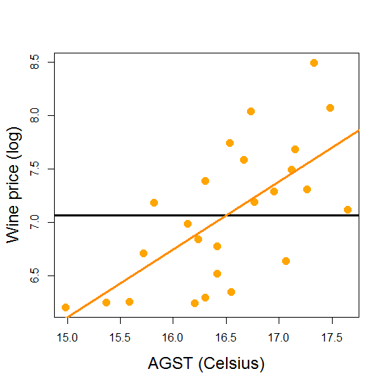


The data and linear relationships
Y = -3.4 + 0.63*X
Y = 7.07 + 0*X
it is a
BASE MODEL

Slide 9
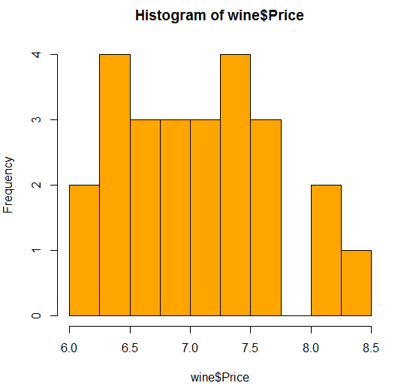

The data and linear relationships
Average price = 7.07

Slide 10
Linear regression model
One variable regression model
y_{i} = β₀ + β₁x_{i} + ε_{i}, i=1,2, …, N
y_{i} - i^{th} observation of dependent variable (wine price)
x_{i} - i^{th} observation of independent variable (AGST)
ε_{i} - error term for the i^{th} observation
β₀ - intercept coefficient
β₁ - regression coefficient for the independent variable
Good models have small error terms ε_{i}

Slide 11



Measuring the fit of the model
RSS =
(ε₁)² + (ε₂)² + … + (ε_{N})²
N – number of data points
TSS = 10.15
RSS = 5.73
ε₃
ε₃

Slide 12



RMSE (Root Mean Square Error)
RSS is hard to use, depends on the number of observations, so cannot be compared if data sets are different
Mean Square Error
Root Mean Square Error

Slide 13

R² or R-squared
TSS = 10.15
RSS = 5.73
Compares RSS in the best model with TSS of the base model
R² = 1- RSS/TSS
= 1 – 5.73/10.15
= 0.44 (44%)
ε₃
ε₃

Slide 14
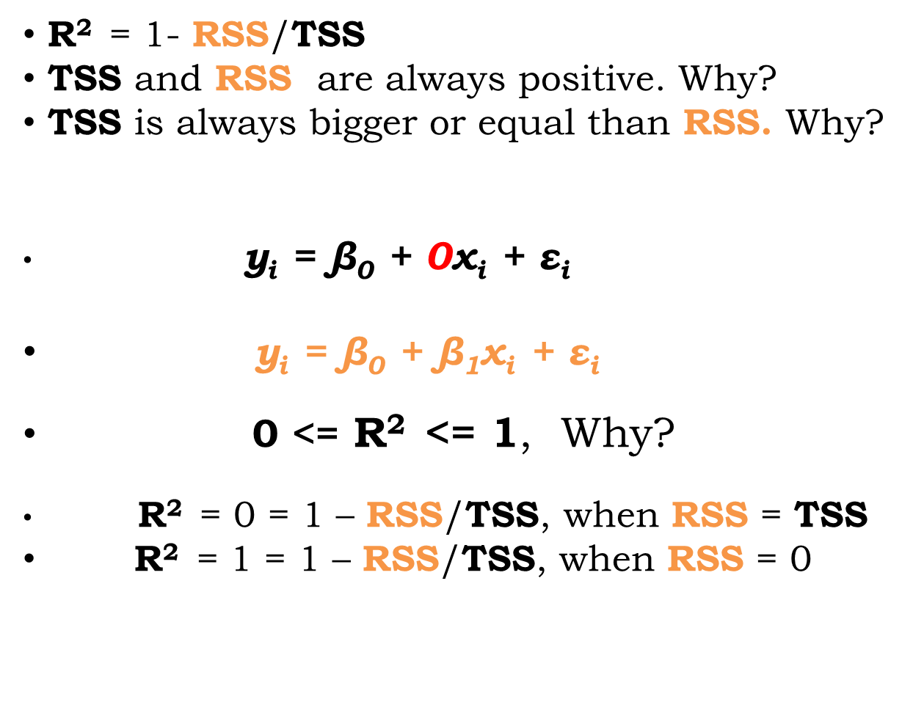
R² or R-squared

Slide 15
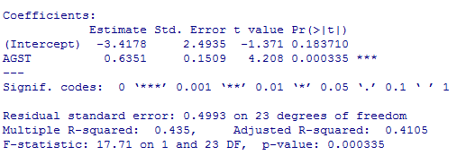
Estimating a regression model
More stars (*) is better, (.) indicates weak significance
Higher growing season temperatures lead to higher price
Our model is better than base model by 41%
Model explains 41% of data viariance

Slide 16
Comparing single variable models
R² for AGST is 0.435
R² for WinterRain is 0.019
R² for HarvestRain 0.317
R² for Age is 0.2
Which model is best?
In Data science best model is the one that makes best predictions

Slide 17
Multivariate linear regression model
  y_{i} = β₀ + β₁x_{1i} + β₂x _{2i} + … + β_{K}x _{Ki} + ε_{i}
i=1,2, …, N
N = number observations
K = number of variables
N-K-1 = number of degrees of freedom (must be positive and cannot be too small)
N should be significantly higher than K

Slide 18
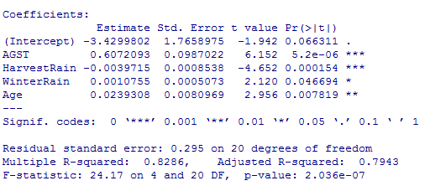
Explaining wine price
Much better R-squared

Slide 19
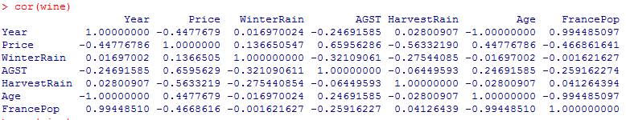
Correlated explanatory variables
This problem is called multicollinearity
Remove correlated explanatory variable(s) from the model (usually when correlation is higher than 0.7 or less that -0.7)

Slide 20
Choosing a model, some basic rules (1)
Independent (explanatory variables should be significant, or almost significant (sample size issue)
Higher R-squared means better model, but only for the same data set, cannot compare R-squared between models estimated for different data
R-squared can be high for simple problems, but low for complicated problems, in both cases we can have good models

Slide 21
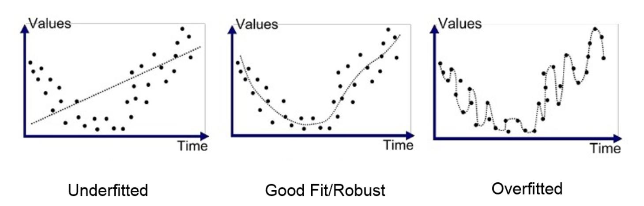
Choosing a model, some basic rules (2)
Adding too many variables can lead to dangerous situation: R-squared is high, but model predicts very poorly – it is called
OVERFITTING
Adjusted R-squared takes into account number of variables („punishes” the model for too many variables)

Slide 22
How wine quality prediction story ends
Parker said that 1986 „very good to sometime exceptional”
Ashenfelter (economist) said:
- 1986 is mediocre
- 1989 will be “the wine of the century” and 1990 will be even better!
In wine auctions,
- 1989 sold for more than twice the price of 1986
- 1990 sold for even higher prices!
Wine quality = 12.145 + 0.00117 WinterRain + 0.0614 AGST -0.00386 HarvestRainfall
http://www.nytimes.com/1990/03/04/us/wine-equation-puts-some-noses-out-of-joint.html

Slide 23
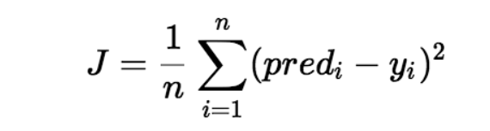
Linear regression as ML algorithm
Consider LR with single feature x
y = a₀ + a₁*x
ML engineers usually do not care about what I said so far (economist approach to linear regression)
They care about minimizing the loss function J:
The loss function minimum is found using gradient descent

Slide 24
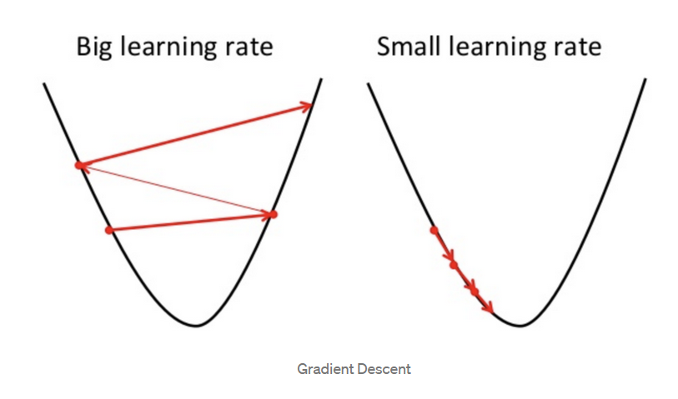

Gradient descent (1)
a1
a1

Slide 25
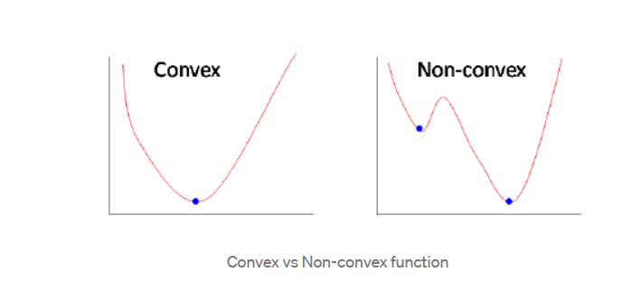
Gradient descent (2)

Slide 26

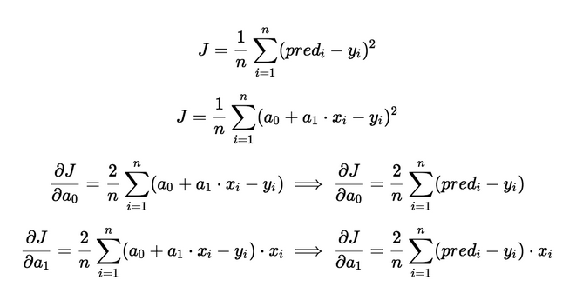
Formula for parameters update (1)
Hint: f = x², df/dx = 2x
f=(a+bx-c)², df/da = 2(a+bx-c), df/db=2(a+bx-c)*x

Slide 27
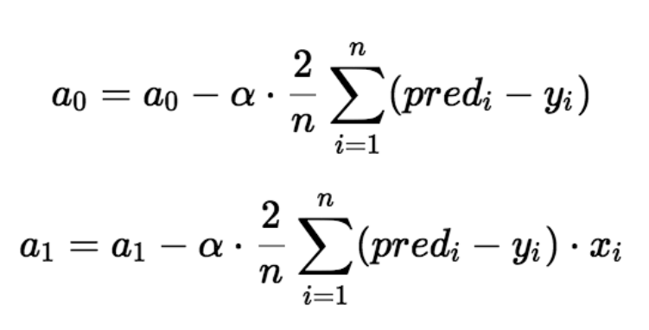

Formula for parameters update (2)
α – learning rate

Slide 28

Questions
If you have questions about the lecture please send me me an email at rybinski@rybinski.eu

Slide 29
Next: Lab 2

Slide 30
prof. Krzysztof Rybinski
rybinski@rybinski.eu
Narxoz: all for the student

